Slide 1
Arrays

Slide 2
Introduction
We have used only the fundamental data types, namely char, int, float, double etc, Although these types are very useful, they are constrained by the fact that a variable of these types can store only one value at any given time.
Therefore, they can be used only to handle limited amount of data.
In many applications, however we need to handle a large volume of data in terms of reading, processing and printing.
To process such large amounts of data, we need a powerful data type that would facilitate efficient storing, accessing and manipulation of data items.
C supports derived data type known as array that can be used for such applications.

Slide 3
Introduction
A fixed size sequenced collection of elements of the same data type
Simply a grouping of like-type data
E.g. list of employees in an organization
Marks of 100 students
List of customers and their telephone numbers
Table of daily rainfall data
Arrays are structured data types
As they can be used to represent data values that have a structure of some sort

Slide 4
Introduction
Since an array provides a convenient structure for representing data, it is classified as one of the data structure in C.
An array is a sequenced collection of related data items that share a common name.

Slide 5
Introduction…
Data Types
Derived data types
Arrays
Functions
Pointers
Fundamental data types
Integral types
Float types
Character types
User-defined data types
Structures
Unions
Enumerated data types

Slide 6
One-dimensional Arrays
One variable with only one subscript
x[0],x[1],x[2],…,x[n]
0,1,2,…n are subscripts and x is a variable
Declaration
type variable-name[size];
float height[50];
char name[10];
Size should be either numeric constant or a symbolic constant
Any reference to the arrays outside the declared limits would not cause an error but might result in unpredictable program results…

Slide 7
One-dimensional Arrays
Size should be either numeric constant or a symbolic constant
#define SIZE 10
int main()
{
int size = 10;
int my_arr1[SIZE];
int my_arr2[size];
}

Slide 8
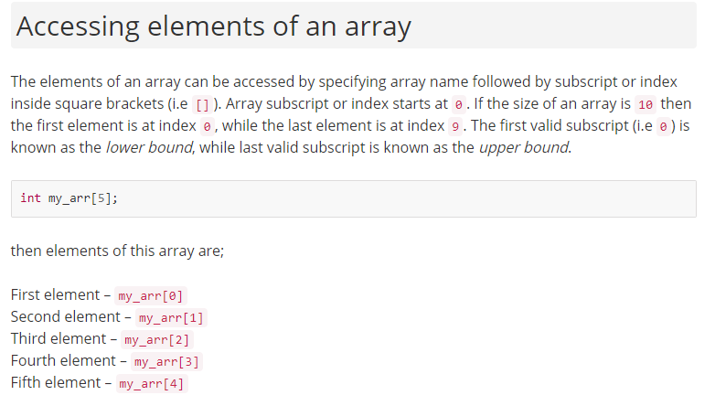
One-dimensional Arrays

Slide 9
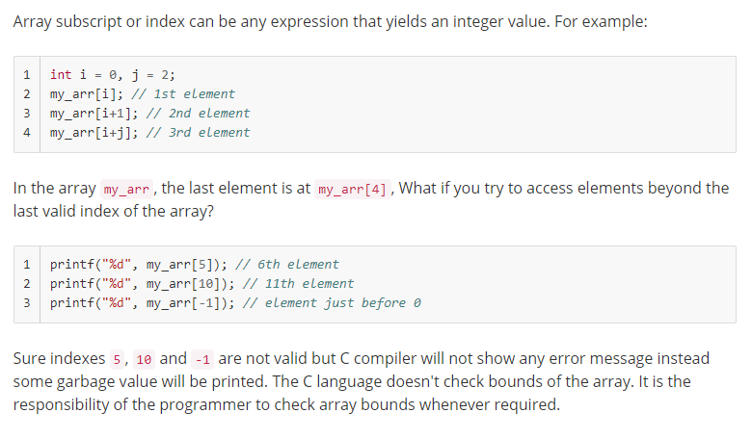
One-dimensional Arrays

Slide 10
One-dimensional Arrays…
char name[10];
Declares the name as a character array variable that can hold a maximum of 10 characters.
The last character in character array must be a null character ‘\0’.
In C it is mostly used to indicate the termination of a character string.
‘W’
‘E’
‘L’
‘L’
‘ ‘
‘C’
‘O’
‘M’
‘E’
‘\0’

Slide 11
Initialization of one-d array
Compile time
Run time

Slide 12
Initialization of one-d array…
Compile time initialization
type array-name[size] = {list of values};
int number[3]={0,0,0};
Declare number as an array of size 3 and initialize each element to 0
float total[5]={0.0,15.3,6.2};
Declare total as an array of size 5 and initialize first three elements to 0.0, 15.3 and 6.2 and remaining elements to 0.0
int number[]={0,0,0};
Declare number as an array of size 3 and initialize each element to 0

Slide 13
Initialization of one-d array…
char name[6]={‘h’,’e’,’l’,’l’,’o’,’\0’};
Declare name as a character array of size 6 and initialize it to “hello”.
Same as,
char name[6]=“hello”;
The following is illegal in C
int x[2]={1,2,3,4};
More elements than array size !!!

Slide 14
Initialization of one-d array…
Run time initialization
int x[10];
for(i=0;i<10;i++)
{
printf(“Enter a number\n”);
scanf(“%d”,&x[i]);
}

Slide 15
Processing 1-D arrays The following program uses for loop to take input and print elements of a 1-D array.
#include<stdio.h>
int main()
{
int arr[5], i;
for(i = 0; i < 5; i++)
{
printf("Enter a[%d]: ", i);
scanf("%d", &arr[i]);
}
printf("\nPrinting elements of the array: \n\n");
for(i = 0; i < 5; i++)
{
printf("%d ", arr[i]);
}
return 0;
}

Slide 16
Program to print the sum of elements of an array.
#include<stdio.h>
int main()
{
int arr[5], i, s = 0;
for(i = 0; i < 5; i++)
{
printf("Enter a[%d]: ", i);
scanf("%d", &arr[i]);
}
for(i = 0; i < 5; i++)
{
s += arr[i];
}
printf("\nSum of elements = %d ", s);
return 0;
}

Slide 17
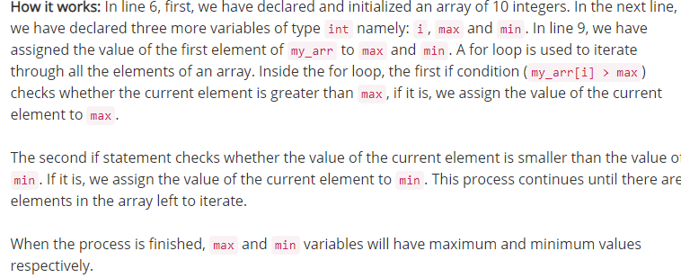
The following program finds the highest and lowest elements in an array.
#include<stdio.h>
#define SIZE 10
int main()
{
int my_arr[SIZE] = {34,56,78,15,43,71,89,34,70,91};
int i, max, min;
max = min = my_arr[0];
for(i = 0; i < SIZE; i++)
{
// if value of current element is greater than previous value
// then assign new value to max
if(my_arr[i] > max)
{
max = my_arr[i];
}
// if the value of current element is less than previous element
// then assign new value to min
if(my_arr[i] < min)
{
min = my_arr[i];
}
}
printf("Lowest value = %d\n", min);
printf("Highest value = %d", max);
return 0;
}

Slide 18
Two dimensional arrays
Lets understand the need of 2-D array with an example.
Let’s say, you want to store the grades of (30) students, each of which is taking 4 number of courses.
We would either use 30 1-D arrays (1 for each student) or 4 1-D arrays (1 for each course).
Multi Dimensional array will allow us to handle all these using a single identifier. 2-D array is the most commonly used multi-dimensional array.

Slide 19
Example
Roll no | Subject 1 | Subject 2 | Subject 3 | Subject 4
1 | 24 | 25 | 26 | 28
2 | 15 | 16 | 17 | 18
3 | 22 | 21 | 12 | 27
4 | 21 | 23 | 24 | 25
… | ----- | .. | .. | ..
30 | 25 | 26 | 27 | 29

Slide 20
Syntax - Two dimensional arrays
The syntax for declaring a two-dimensional array is:
dataType arrayName[rowsize][colsize];
where rowsize and colsize are expressions yielding positive integer values
The two expressions rowsize and colsize specify the number of rows and the number of columns, respectively, in the array.
Two-dimensional arrays are sometimes called matrices or tables.

Slide 21
Representation of the example
Columns represents Subjects and Rows represent Students
[0]
[1]
[2]
[3]
[4]
[0]
50 [0][0] | 60 [0][1] | 65 [0][2] | 75 [0][3] | 63 [0][4]
55 [1][0] | 56 [1][1] | 39 [1][2] | 43 [1][3] | 79 [1][4]
78 [2][0] | 59 [2][1] | 83 [2][2] | 92 [2][3] | 85 [2][4]
49 [3][0] | 81 [3][1] | 67 [3][2] | 65 [3][3] | 72 [3][4]
53 [4][0] | 55 [4][1] | 97 [4][2] | 82 [4][3] | 77 [4][4]
85 [5][0] | 83 [5][1] | 92 [5][2] | 75 [5][3] | 81 [5][4]
… | … | … | … | …
… | … | … | … | …
… | … | … | … | …
… | … | … | … | …
79 [29][0] | 83 [29][1] | 59 [29][2] | 69 [29][3] | 82 [29][4]
[1]
[2]
[3]
[4]
[5]
…………………
[29]

Slide 22
Initializing 2D array
Run-time initialization
int sales[4][3];
for(int i=0;i<4;i++)
for(int j=0;j<3;j++)
scanf(“%d”, &sales[i][j]);

Slide 23
Initializing 2D array…
Compile-time initialization
int table[2][3]={0,0,0,1,1,1}; initializes the elements of first row to 0 and second row to 1.
int table[2][3]={{0,0,0},{1,1,1}}; does the same thing
int table[][3]={{0,0,0},{1,1,1}}; is permitted if all elements of the array are initialized. The statement will initialize table with 2 rows and 3 columns
What about
int table[2][3]={{1,1},{0}};
int table[3][5]={{0},{0},{0}};
int table[3][5]={0};

Slide 24
A program illustrating 2D arrays
A Program to add two matrices
1 | 1 | 1
2 | 2 | 2
3 | 3 | 3
4 | 4 | 4
5 | 5 | 5
6 | 6 | 6
5 | 5 | 5
7 | 7 | 7
9 | 9 | 9
+
=

Slide 25
Void main()
{
int a[3][3], b[3][3], c[3][3], i, j;
printf(“Enter 3*3 matrix A\n”);
for(i=0;i<3;i++)
{
for(j=0;j<3;j++)
{
scanf(“%d”,&a[i][j]);
}
}
printf(“Enter 3*3 matrix B\n”);
for(i=0;i<3;i++)
{
for(j=0;j<3;j++)
{
scanf(“%d”,&b[i][j]);
}
}

Slide 26
for(i=0;i<3;i++)
{
for(j=0;j<3;j++)
{
c[i][j] = a[i][j] + b[i][j];
}
}
Printf(“Resultant matrix C\n”);
for(i=0;i<3;i++)
{
for(j=0;j<3;j++)
{
printf(“%d\t”,c[i][j]);
}
printf(“\n”);
}
}

Slide 27
A program illustrating 2D arrays…
A program to count number of positive, negative and zero elements from 3*3 matrix
1 | 0 | -2
3 | -3 | 3
0 | 5 | 5
Positive Number = 5
Negative Number = 2
Zero Elements = 2

Slide 28
int a[3][3], i, j, positive=0, negative=0, zeros=0;
printf(“Enter 3*3 matrix A\n”);
for(i=0;i<3;i++)
{
for(j=0;j<3;j++)
{
scanf(“%d”,&a[i][j]);
if(a[i][j]>0)
positive++;
else if(a[i][j]<0)
negative++;
else
zeros++;
}
}
printf(“Positive Number = %d\n”, positive);
printf(“Negative Number = %d\n”,negative);
printf(“Zero Elements = %d\n”, zeros);

Slide 29
A program illustrating 2D arrays…
A program to sort all the elements of 2-D array row wise having 3 rows and 3 columns
1 | 3 | 2
6 | 4 | 8
5 | 3 | 9
1 | 2 | 3
4 | 6 | 8
3 | 5 | 9

Slide 30
int a[3][3], i, j, k, temp;
printf(“Enter 3*3 matrix A\n”);
for(i=0;i<3;i++)
{
for(j=0;j<3;j++)
{
scanf(“%d”,&a[i][j]);
}
}
for(i=0;i<3;i++)
{
for(j=0;j<2;j++)
{
for(k=j+1; k<3; k++)
{
if(a[i][j] > a[i][k])
{
temp = a[i][j];
a[i][j] = a[i][k];
a[i][k] = temp;
}
}
}
}

Slide 31
printf(“Row by Row sorted \n”);
for(i=0;i<3;i++)
{
for(j=0;j<3;j++)
{
printf(“%d\t”,a[i][j]);
}
printf(“\n”);
}
}

Slide 32
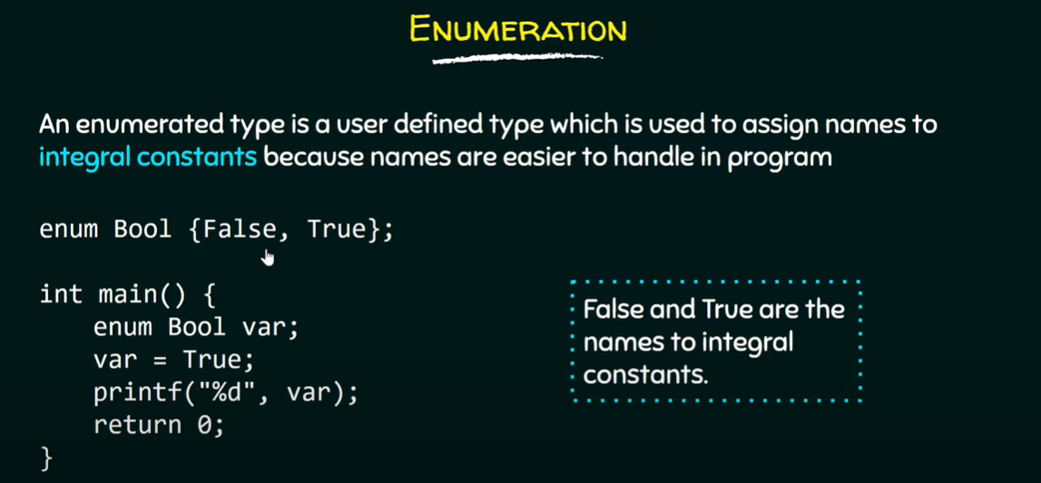
Enumerated data types

Slide 33
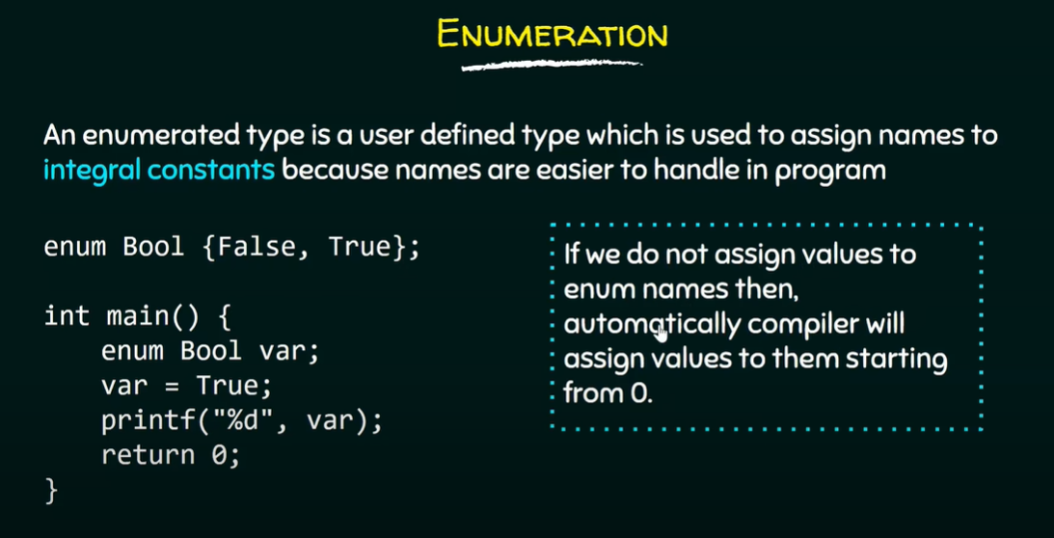

Slide 34


Slide 35
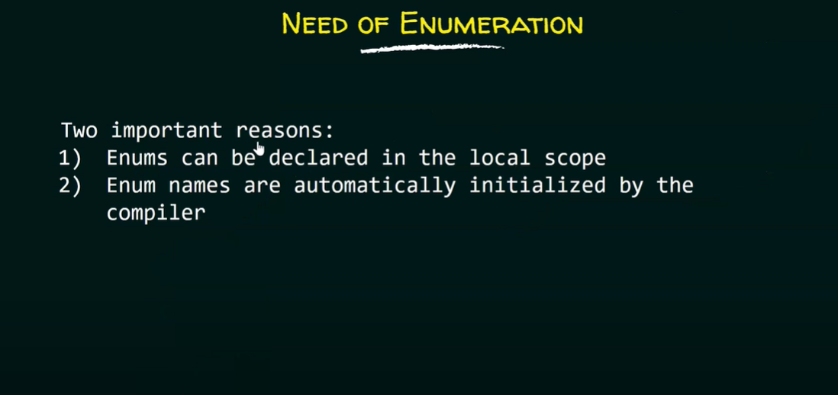

Slide 36
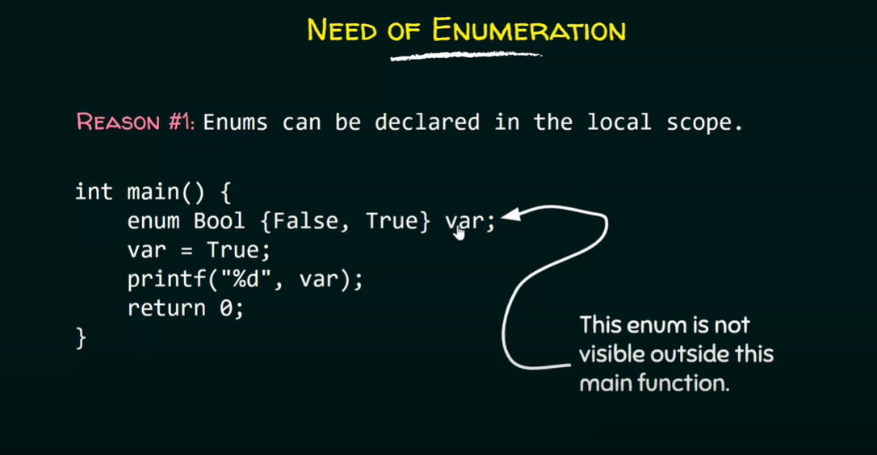

Slide 37
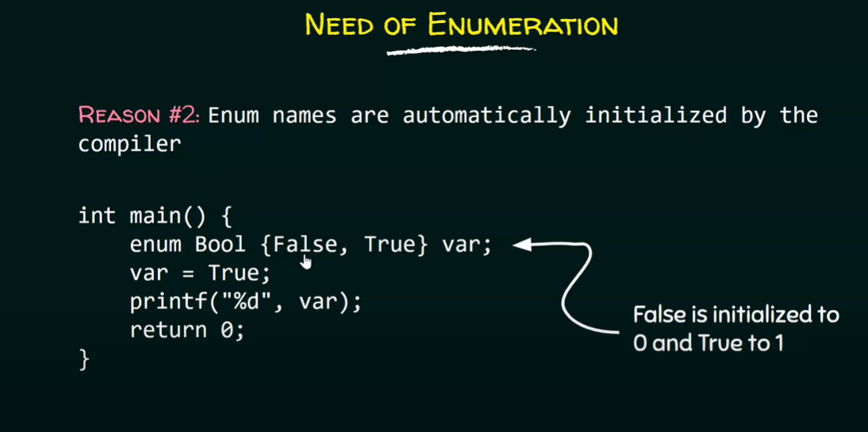

Slide 38
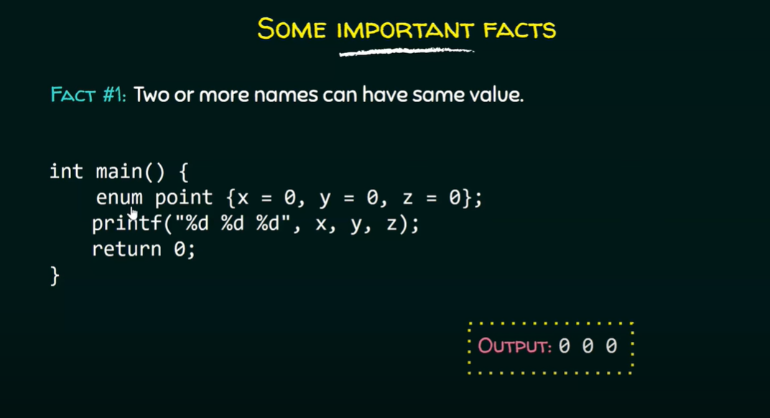

Slide 39
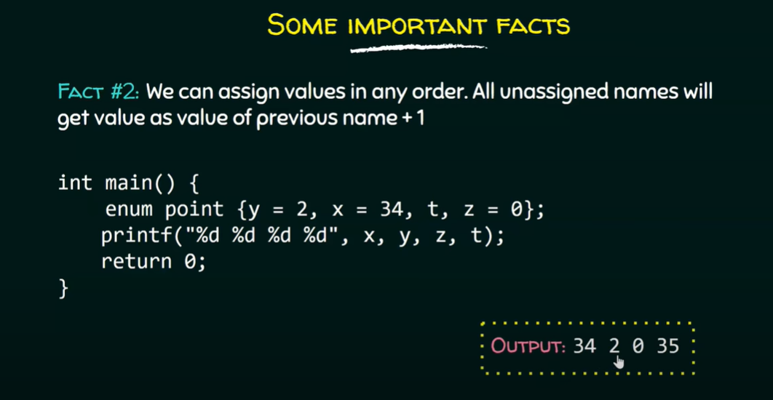

Slide 40
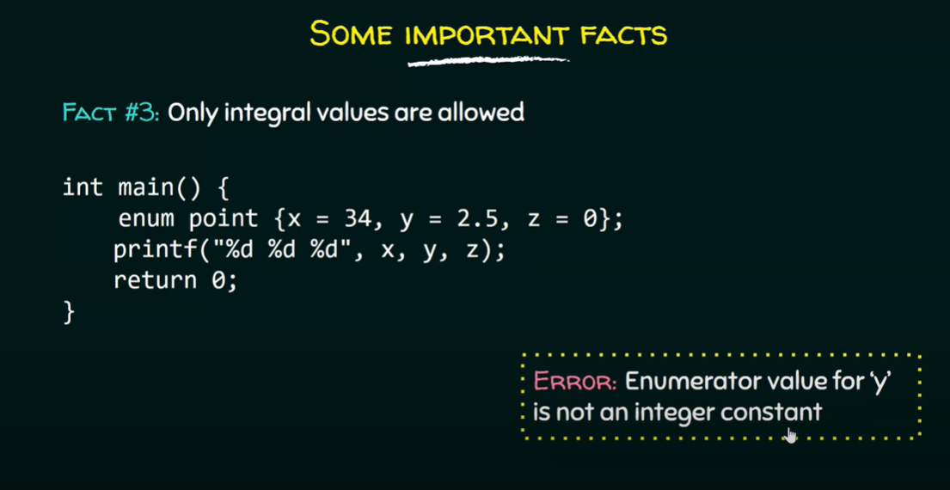

Slide 41
